Slide 1
MongoDB

Slide 2
What is MongoDB?
MongoDB is a document-oriented NoSQL database syste.
It provides high scalability, flexibility, and performance.
Unlike standard relational databases, MongoDB stores data in a JSON document structure form.
This makes it easy to operate with dynamic and unstructured data.
MongoDB is an open-source and cross-platform database System.

Slide 3
Mongodb Database and Collection
Database
Database is a container for collections.
Each database gets its own set of files.
A single MongoDB server can has multiple databases.
Collection
Collection is a group of documents.
Collection is equivalent to RDBMS table.
A collection consist inside a single database.
Collections do not enforce a schema.
A Collection can have different fields within a Documents.

Slide 4
Why MongoDB?
Index on any attribute: Indexing in MongoDB allows for faster data retrieval by creating a searchable structure on selected attributes, optimizing query performance.
Replication and high availability: MongoDB’s replica sets ensure data redundancy by maintaining multiple copies of the data, providing fault tolerance and continuous availability even in case of server failures.
Auto-Sharding: Auto-sharding in MongoDB automatically distributes data across multiple servers, enabling horizontal scaling and efficient handling of large datasets.
Big Data and Real-time Application: When dealing with massive datasets or applications requiring real-time data updates, MongoDB’s flexibility and scalability prove advantageous.
Rich queries: MongoDB supports complex queries with a variety of operators, allowing you to retrieve, filter, and manipulate data in a flexible and powerful manner.
Fast in-place updates: MongoDB efficiently updates documents directly in their place, minimizing data movement and reducing write overhead.
Professional support by MongoDB: MongoDB offers expert technical support and resources to help users with any issues or challenges they may encounter during their database operations.
Internet of Things (IoT) Applications: Storing and analyzing sensor data with its diverse formats often aligns well with MongoDB’s document structure.

Slide 5
Where to use MongoDB?
Mobile and Social Infrastructure
Data Hub
Previous Pag
Big Data
User Data Management
Content Management and Delivery

Slide 6
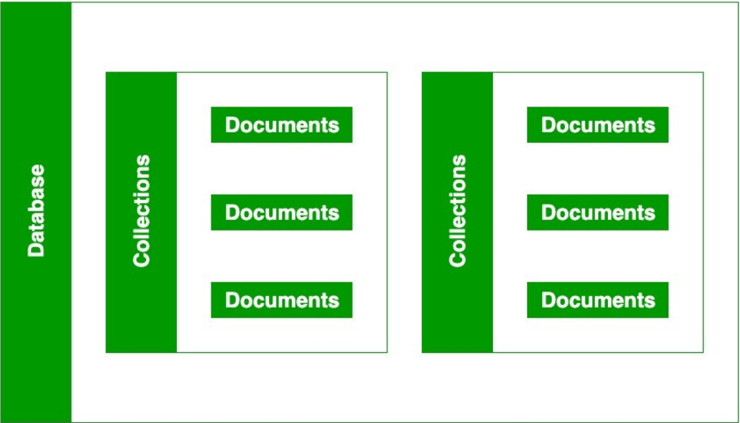
Database, Collections and Documents
A Database can contain many collection.
A collection contains documents.
Documents contain data, they are related to each other.

